Slide 1
Trauma informed care (the recovery approach to mental health)

Slide 2
A bit of history
To this day the dominant approach is the biomedical approach (diagnoses and treatment)
This has evidenced based poor-efficacy (when used alone)
Eg. Getting a diagnosis/label often comes with short term relief
“OH now so much of my life makes sense”
Which is then shortly followed by
“OH this is why my life sucks”
And psychopharmaceutical drugs (particularly antidepressants) very much like getting a diagnosis, shows great short-term efficacy (we are talking weeks-months), but poor long term.
Currently we are in a major paradigm shift towards the recovery approach which is a trauma-informed framework
The ex-NSW Mental health care commissioners quote during my training with him was “the worst thing that has happened to mental health is the removal of psychotherapy from psychiatry”
This implies that for best outcome, a mixture of both biomedical and recovery approaches would prove most efficacious

Slide 3
What is the recovery approach / trauma informed care?
Living a good life with or without symptoms
Strengths based rather than symptoms based
Avoids labelling (diagnoses and symptoms unless the consumer prefers that)
Being trauma aware (deep topic will make slides if requested)
Focusses on reasonable personal recovery rather than health worker defined recovery
Hence, is more person centred rather than task oriented (that being said a biomedical approach user can be person centerer, just like a recovery approach user can be task oriented)

Slide 4
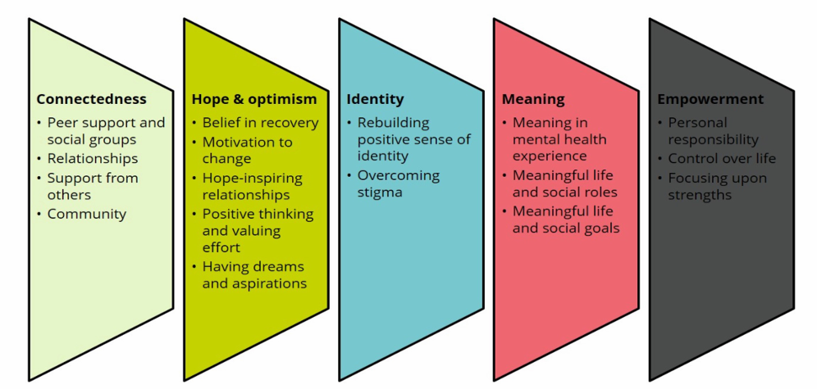
The CHIME framework for personal recovery
The recovery approach is labelled as doing subjectively well in the following 5 domains

Slide 5
Overall difference: Personal (recovery approach) vs clinical (biomedical approach) recovery
PERSONAL RECOVERY
CLINICAL RECOVERY
Self-determination a basic human
Rights respected
Active participation and empowerment is valued
Collaborative relationships, lived and learnt expertise
Respect-based language
Capitalise on strengths and life experiences
Achieving broad-based life goals
Clinical stability then self determination
Compliance with treatments and plans is valued
Mostly one-directional professional led
Jargon and labels
Symptoms, disabilities, deficits focus of treatment
Narrow goals of illness management

Slide 6
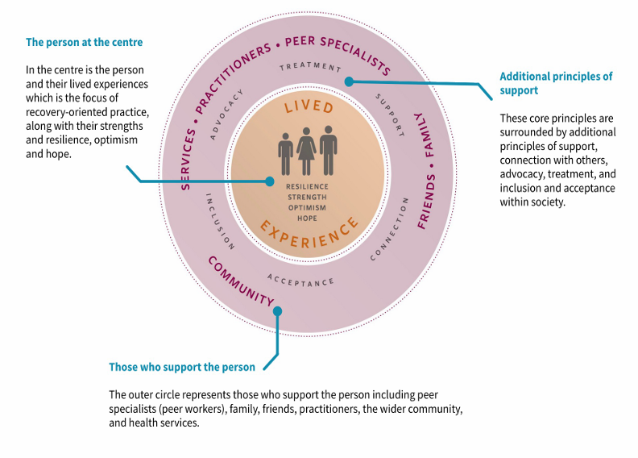
Key principles

Slide 7
Recovery Oriented Language
Recovery-Oriented-Language-Guide-3rd-edition.pdf
Focus on NOT using language of deficit
Person rather than diagnosis
E.g., not ’he is mentally ill’ or ‘a schizophrenic’
He is a person with lived experience of mental distress
He is a person who has been diagnosed with schizophrenia
But persons preferences really matter
Communicates a sense of hope, strengths, respect
E.g. not condescending, patronizing, or negative
Not ‘they suffer from’ or ‘they are a victim of’
But ‘they have lived or living experience of’

Slide 8
Other language considerations
Words such as ‘mad’ ‘crazy’ have been reclaimed by people with lived experience
People talk of ‘mad pride’ etc.
However:
People may take offence at these terms
Issue of overuse of terms such as crazy, psychotic, mad to describe negative things, people, or events
What do we mean when we say this?
Consider changing your language to other words e.g.
I had a ‘wild day’ or a ‘chaotic day’ not a ‘mad’ day or ‘crazy’ day
Why?
Language matters, conveys negativity about mental distress
When you work with people with lived experience, they may be sensitive to negative connotations

Slide 9
What is recovery-oriented practice?
Recognise uniqueness of the individual
Trust expertise of the person (people can be experts by lived experience of distress, and everyone is an expert about themselves)
Focus on person not on diagnosis
Hope in possibility of recovery (recovery as defined by the person)
Recognising strengths of the person
If you meet them, likely they are already started their recovery journey
Recognizing need for connection and meaning, need to explore identity and have power in their care process
Recognizing social genesis of distress
Recognizing and responding to trauma
Supporting real choice and power
Walk alongside, not directive
Dignity and respect for rights and self-determination
Acknowledge diversity of experience, culture and values
Partnership and communication
Prioritising relational connection with people with lived experience
Connect and collaborate with the person
Empathy and action to support the person
Person first, recovery-oriented language

Slide 10
Ongoing tensions
Personal recovery often confused with clinical recovery
Emphasis on psychiatric treatment rather than personal recovery
“Recovery in the Bin” C/S/X movement
“fed up with the way co-opted ‘recovery’ is being used to discipline and control those who are trying to find a place in the world, to live as they wish, trying to deal with the very real mental distress they encounter on a daily basis. We believe in human rights and social justice!”
Idea of right to be ‘unrecovered’ (e.g. not clinically recovered)
Link distress to social structure, rather than individual responsibility for recovery
How can you recover in a world that is ‘crazy making’

Slide 11
Useful Resources
100 Ways to support recovery 2nd edition.pdf (targeted towards mental health professionals but can be useful if you skim past something you can easily do)
Section 2 has a nice section on the Peer Support Workers that Cyndi mentioned (page 11-14)
One important thing it did not highlight is having someone go through similar experiences and come out personally recovered not only is inspirational, motivational, but makes the consumer more easily to engage in mental health services (and the peer worker is an excellent resource to guide them through this)
Resources - Mental Health Coordinating Council
Of note:
Already mentioned recovery-oriented language
TICPOT – an organisational auditing tool to make your workplace recovery-oriented
Trauma-informed language tips (simple version of the above)
Trauma-informed leadership for organisation change: A framework

